Slide 1
Scalable Systems 1
Prashant
System Design Instructor @ IK
Engineering @ Microsoft

Slide 2
Today’s Agenda
Introduction
Prerequisites
Problem solving Framework
Brief Intro to Scalable Systems
Online processing: Design 1, Design Instagram & News Feed
Online processing: Design 2
Notes:
Go over the agenda quickly.

Slide 3
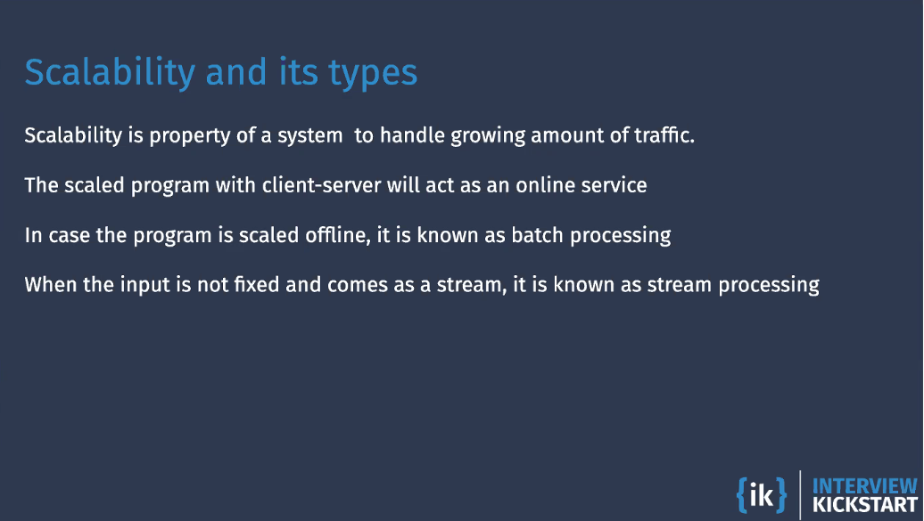

Slide 4
Difference between DSA and System Design
Notes:
Go over the agenda quickly.

Slide 5
What changes when we move from DS/Algo to SysD?
In DSA, for a given computational Problem
Design a correct & efficient algorithm
Code it up
Assumption:
Only one user
Program will run only once
Unbounded CPU and ram to solve the problem
Notes:
Go over the agenda quickly.

Slide 6
What changes when we move from DS/Algo to SysD?
In System design,
Your DS/Algos program is now a service in System design.
The users of the service known as clients
May want to execute program remotely over network
Will need to request your server machine to run the program using the inputs they send over the network.
Your server machine
Needs to send the output of a request as a response over the network.
Needs to always be actively listening for requests
Notes:
Go over the agenda quickly.

Slide 7
What changes when we move from DS/Algo to SysD?
Your program needs to be scalable if it can handle huge growth in the load (number of concurrent requests) without sacrificing the response time.
The standalone program is converted into an online service and will see how to build such an online service.
Notes:
Go over the agenda quickly.

Slide 8
Top-Down steps for system design in an interview
Notes:
Go over the agenda quickly.

Slide 9
Step 1: Gather all requirements of the system
Gather functional requirements. a. This is the detailed problem statement. b. Describe user’s view of system in plain English c. Shows that you can communicate and unpack an open-ended problem d. Ask clarifying questions.
Design constraints/scalability requirements. a. Number of users, transactions per second etc. b. The interviewer may give them or may ask the candidate. c. Can be collected at a later step as well.
Notes:
Go over the agenda quickly.

Slide 10
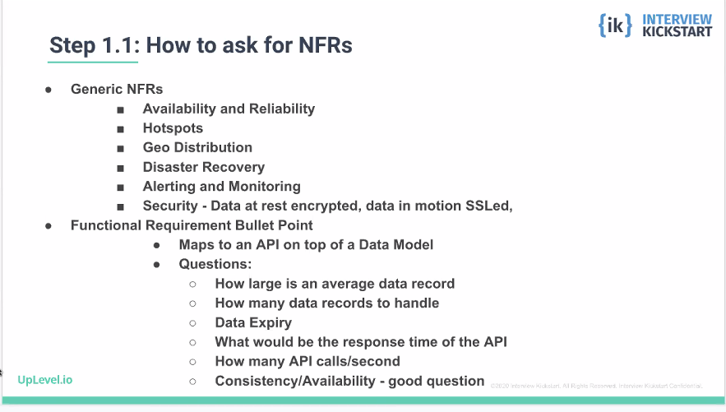
Notes:
Go over the agenda quickly.

Slide 11
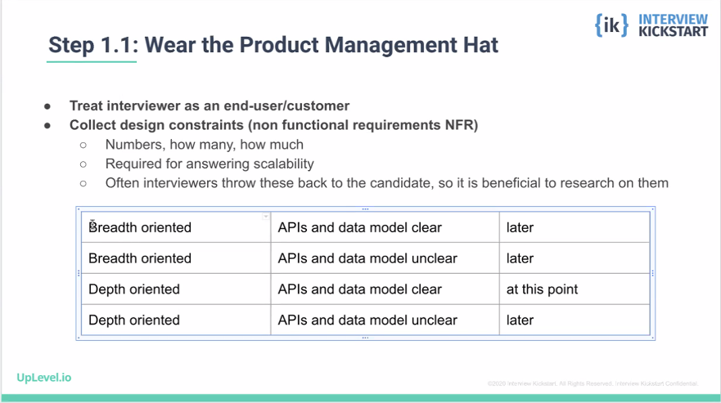
Notes:
Go over the agenda quickly.

Slide 12
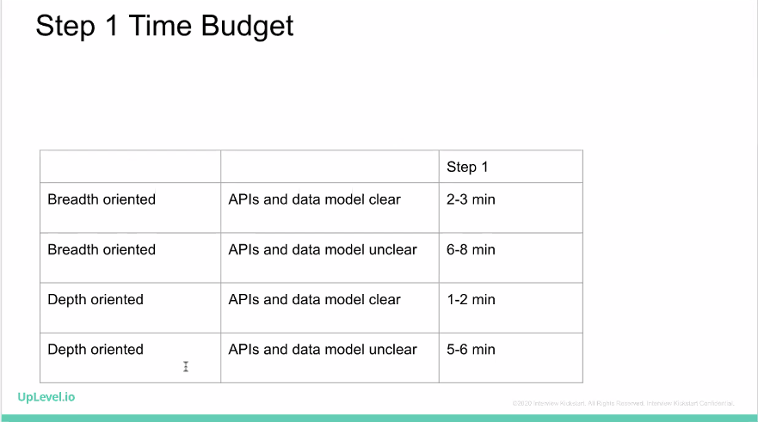
Notes:
Go over the agenda quickly.

Slide 13
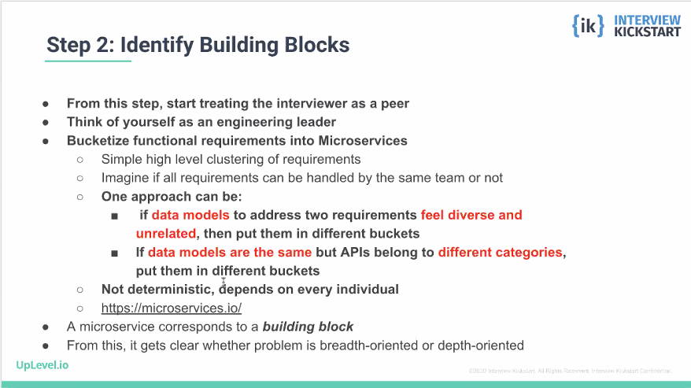
Notes:
Go over the agenda quickly.

Slide 14
Step 2: Defining Microservices of the system
A microservice
Is an independently deployable service modelled around a business domain.
Loosely coupled, you can change one microservice and deploy it into production without affecting other microservices.
Each Microservice is a black box to other microservice with endpoints exposed.
Small and focused on doing one thing well: owned by a single (2pizza) team
Communicate with each other using language-independent networks APIs (Rest with HTTP).
Notes:
Go over the agenda quickly.

Slide 15
Step 2: Defining Microservices of the system
Bucketize the functional requirements into microservices.
Cluster the requirements such that each cluster can be handled by a different team.
Rule of thumb: if the APIs and data models for 2 functional requirements do not look the same, put them in different buckets.
This is subjective, depends on the individual
After doing this, you will know whether it’s a depth-oriented problem(~ 1 microservice) or breadth-oriented problem(many microservices)
Notes:
Go over the agenda quickly.

Slide 16
Step 3: Design the logical architecture
The logical architecture is a block diagram with one block for each microservice.
Draw and explain the data/logic flow between them.
Rule of thumb:
If the client(user or microservice) is waiting for response from the microservice use HTTP/REST APIs
If the client microservice does not expect an immediate response from the server microservice, use a message queue(pub-sub) which is its own microservice.
If data transfer is online, you may use batched ETL(Extract Transform Load) jobs.
Notes:
Go over the agenda quickly.

Slide 17
Step 4: Deep dive into each microservice
High-level microservice architecture:
In general, each microservice can have, up to three tiers:
Backend tier with business logic(App server) – this is where your single-machine code conceptually goes
Cache tier for faster response time(cache) – data here is a subset of the database tier, but can be stored in any format/data structure
Storage tier for data storage and retrieval(Database): store in row-major/col-major/files (for movies and other unstructured formats)
Note: we don’t worry about front-end tier
Notes:
Go over the agenda quickly.

Slide 18
Step 4: Deep dive into each microservice
Propose flow across tiers within the microservice
Most of the technical design interviews have meat in this phase
Non-deterministic, every candidate will come with his or her own proposal
Changes from problem to problem
This constitutes the most thinking portion of the interview
Most changes to flunk here unless candidate is prepared
Notes:
Go over the agenda quickly.

Slide 19
Step 5: Identify the need for scale
In each microservice, identify the need for scale
A deterministic set of reasons can be poses across all interview
Need to scale for storage(storage and cache tiers)
Need to scale for throughput(CPU/IO)
Need to scale for API Parallelization
Need to remove hotspots
Availability and geo-distribution
Notes:
Go over the agenda quickly.

Slide 20
Step 5: Identify the need for scale
The constraints or numbers change from problem to problem
Solve algebraically first and then put numbers. Algebraic formula for all problems
If phase 1 takes more time, don’t spend time on calculations/estimations here unless asked for
Notes:
Go over the agenda quickly.

Slide 21
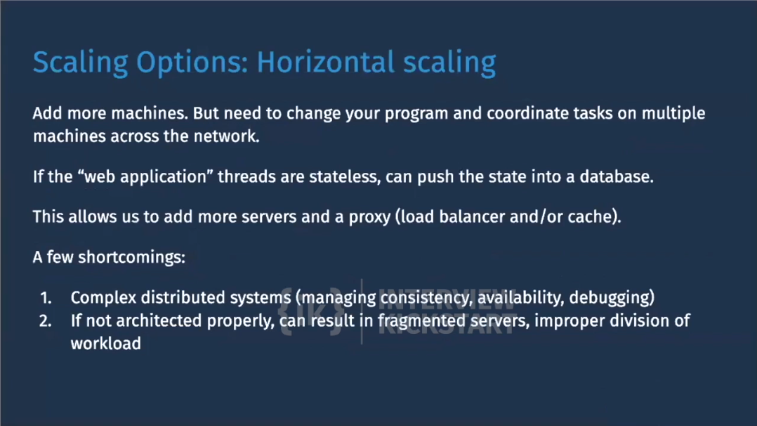
Notes:
Go over the agenda quickly.

Slide 22
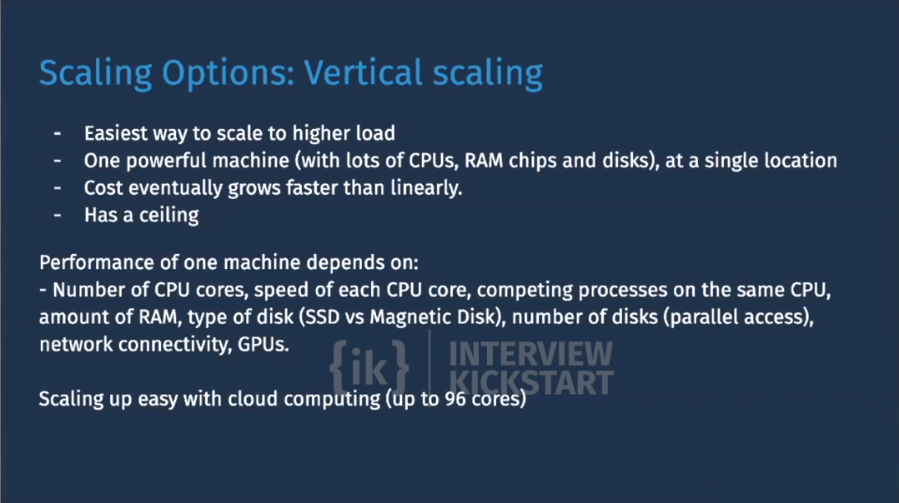
Notes:
Go over the agenda quickly.

Slide 23
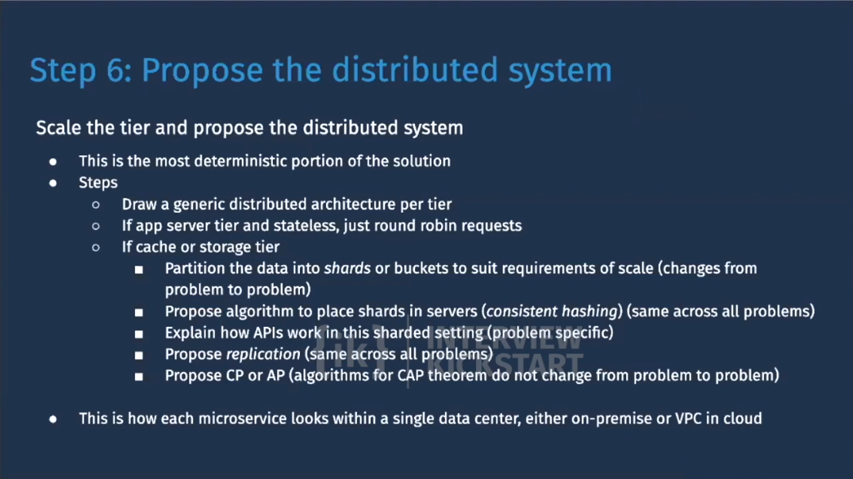
Notes:
Go over the agenda quickly.

Slide 24
Problem 1
Online processing: Design Instagram & News Feed

Slide 25
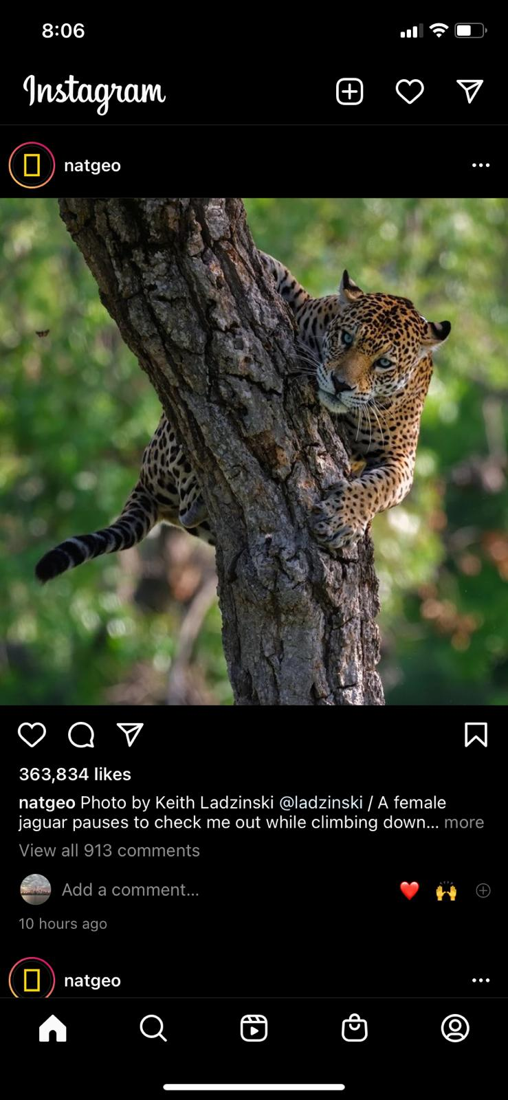
Step 1: Gathering Requirements
Functional Requirements:
Upload photo(s).
View photo(s).
Follow/unfollow other users.
Generate a news feed, based on who the user follows.
Notes:
The functional requirements could be given by the interviewer, or the interviewer may say “Design Instagram”.
In the later case, following are some examples of what you should discuss as options. Interviewer will ask you to focus on a subset of these.

Slide 26
Step 1: Gathering Requirements
Non Functional Requirements
Service needs to be highly available (prefer availability over consistency).
Acceptable latency of X milliseconds to generate the news feed, Y milliseconds to view a photo.
The systems needs to be highly reliable (no lost photos)
Total users ~= 1 billion
Daily active users ~= 500 million
New photos per second ~= 1000
Average photo file size ~= 200kb
Avg num of timeline fetches a day by each active user ~= 10

Slide 27
Identify APIs according to Functional Requirements
Users should be able to upload and view photos.
viewPhoto(photo_id, user_id)
viewPhotos(user_id)
postPhoto(user_id, photo, location, time_stamp, title, tags[])
Users should be able to follow/unfollow other users.
follow(follower_id, followee_id, time_stamp)
unfollow(follower_id, followee_id, time_stamp)
System should generate a news feed for the user, based on who the user follows.
generateFeed(user_id, time_stamp, batch_size, batch_range[])

Slide 28
Data Model
UserTable
FollowTable
NewsFeedTable
UserID (pk) | int64
Name | varchar32
Email | varchar32
DOB | datetime
Zipcode | int
CreateTime | datetime
LastLogin | datetime
UserID | int64
FeedItemId | int64
PhotoID | int64
TimeStamp | datetime
Photo Table
PhotoID (pk) | int64
UserID | int64
Description | varchar64
ImgStorePath | varchar64
ThumbnailPath | varchar64
Latitude | int
Longitude | int
TimeStamp | datetime
FollowerID (pk) | int64
FolloweeID (+pk) | int64
TimeStamp | datetime

Slide 29
Step 2: Defining Microservices
ViewService
PostService
FollowService
NewsFeedService
AccountService
Breadth Oriented Problem
Notes:
Demonstrate how to identify the microservices based on functional requirements. You can take an example of feed generation service.

Slide 30
Step 3: Logical block diagram
API Gateway / Web Servers
FollowSvc
PostSvc
NewsFeed
Svc
ViewSvc
AccountSvc
Notes:
Draw the links while explaining how the data flow happens.

Slide 31
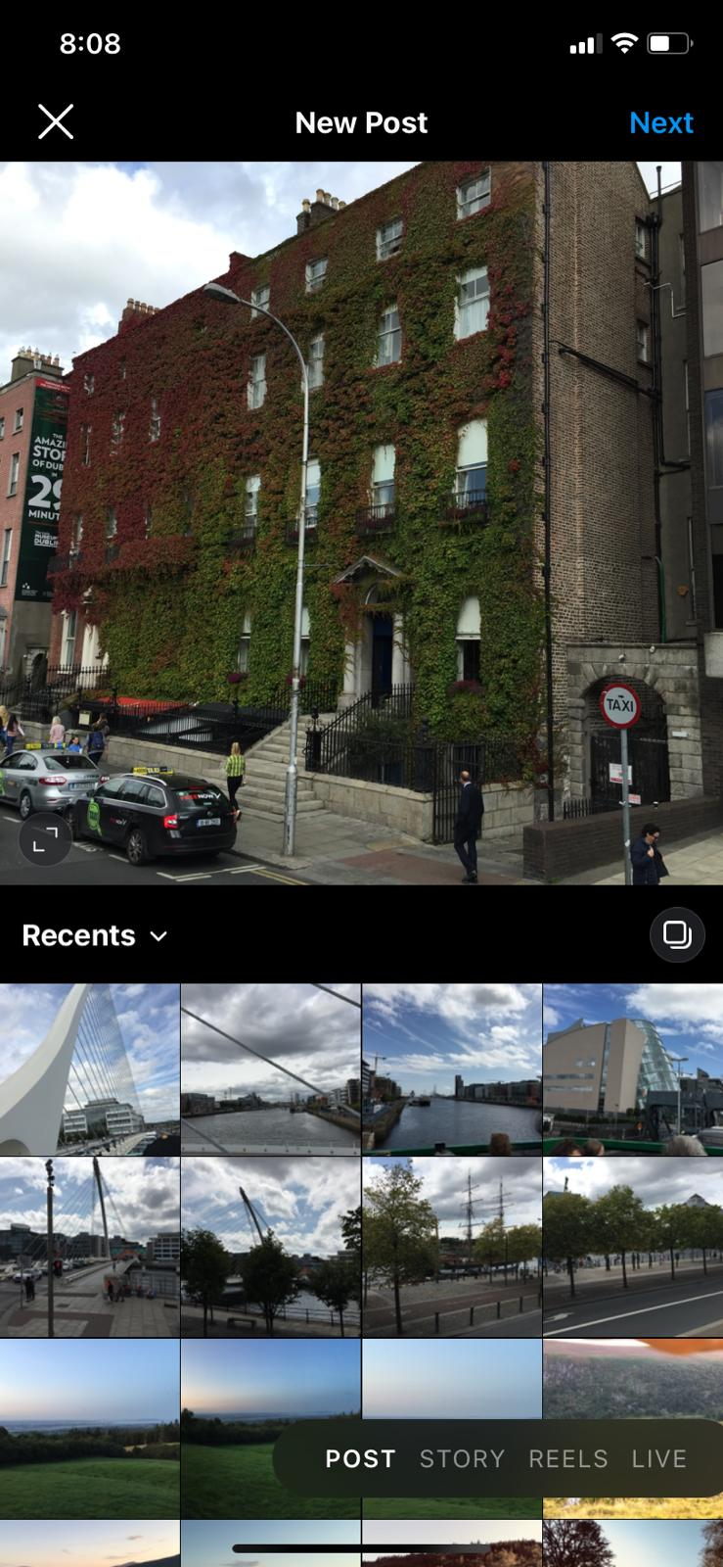
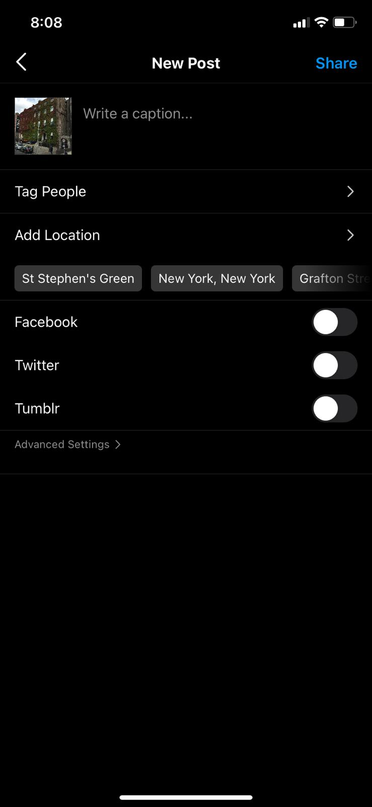

Step 4: PostService
Tiers: App server tier, Cache or In-memory tier, Storage tier
Flow of APIs
Phone app converts the photo in proper resolution and format
App asks the server for a signed URL
Server creates meta-data rec in db, returns signed URL
App directly stores the img in img store using the signed URL
App communicates success/failure to the server
Server updates meta-data record
Data Model: K-V pair
K: PhotoID: V: desc, img store path, other properties
Cache tier - Not needed
How to store in Storage tier - as a row oriented K-V store
APIs
postPhoto(userID, location, time_stamp, ...)
Algorithm in APIs
Generate photo id (Snowflake or KGS?)
Generate signed URL
Create(K.V) - CRUD
Client
PostService (App Tier)
ImageStore
DB

Slide 32
Step 5: Recall scaling up the solution
For each microservice
Check whether each tier needs to scale
A deterministic set of reasons can be posed across all interviews
Need to scale for storage (storage and cache tiers)
Need to scale for throughput (CPU/IO)
Need to scale for API parallelization
Need to remove hotspots
Availability and Geo-distribution
The constraints or numbers change from problem to problem
Solve algebraically first and then put numbers. Algebraic formula is same for all problems
If phase 1 takes more time, do not spend time on calculations unless asked for.

Slide 33
Step 5: PostService:
For each microservice
A deterministic set of reasons can be posed across all interviews
Need to scale for storage (storage and cache tiers) - Yes
Need to scale for throughput (CPU/IO) - Yes
Need to scale for API parallelization - No
Need to remove hotspots - No
Availability and Geo-distribution - Yes
Solve algebraically first and then put numbers
Total users ~= 1 billion
Daily active users ~= 500 million
New photos per second ~= 1000
Average photo file size ~= 200kb
Let’s look at each tier separately.

Slide 34
Step 5: PostService:
DB Tier
Image store estimation
Total space required for 10 years of photos (w/o replication or growth)
= 10 years * ~400 days per year * ~100k sec in a day * 1000 pic per s * 200 kb
= 80,000,000,000,000,000 b = ~80 Pb
(more space will be needed for replication)
Meta-data estimation
PhotoTable: PhotoId(int64) + UserId(int64) + title(varchar 64) + ImgStorePath(varchar 64) + ThumbnailPath (varchar 64) + PhotoLatitude(int) + PhotoLongitude(int) + TimeStamp(datetime) + numLikes(int) + numComments(int) = 228 bytes per row * 400 billion photos ~= 100 TB w/o replication.

Slide 35
Step 5: PostService:
App Tier
Let t = CPU work time in ms from a single thread
So number of operations per second handled by single thread = 1000/t
Number of concurrent threads in a commodity server = 100-200 (determined by experiments)
So the number of API calls a server can handle per second ~ 100000/t, operating at full capacity.
But typical servers operate at 30-40% capacity, so roughly 30000/t API calls per server.
Assuming creating signed URL and later on updating the DB each take ~30 ms.
Plug in t = 30 ms in above formula = 30000/30 = 1000 rps per server
For 1000 photos per sec, we’ll have 2000 operations (1 for signed URL and 1 for updating the DB) ~= 2 servers.
The correctness of above will be determined by optimal number of threads.

Slide 36
Step 6: Recall proposing the distributed architecture
For each microservice
If a tier needs scale, scale the tier and propose the distributed system
This is the most deterministic portion of the solution
Steps
Draw a generic distributed architecture per tier
If app server tier and stateless, just round robin requests
If cache or storage tier
Partition the data into shards or buckets to suit requirements of scale (changes from problem to problem)
Propose algorithm to place shards in servers (consistent hashing) (same across all problems)
Explain how APIs work in this sharded setting (problem specific)
Propose replication (same across all problems)
Propose CP or AP (algorithms for CAP theorem do not change from problem to problem)
This is how each microservice looks within a single data center, either on-premise or VPC in cloud

Slide 37
Step 6: PostService: Reasons for partitioning / sharding
If the size of the data is very large
If the query throughput is very high (and includes writes)
PhotoTable ~= 100 TB w/o replication.
Assuming 1 shard could hold 4TB, we’ll need ~25 shards (w/o replication). But what should we shard on?
UserID
PhotoID

Slide 38
Step 6: PostService:
Given a key, which node should I go to (ignore replication for now)? And once I am at the right node, how do I access the relevant record?
Option 1: Assign records to nodes randomly. Would this work? Option 2: Based on key range Option 3: Based on the “hash of the key” range

Slide 39
Step 6: PostService
Sharding
Horizontal sharding
Map subsets of photos to a single shards
Placement of shards in servers
Consistent hashing
Replication
Yes for availability as well as for throughput
To reduce latency for geographically distributed users
CP or AP?
AP: does not need to be strictly nanosecond level consistent

Slide 40
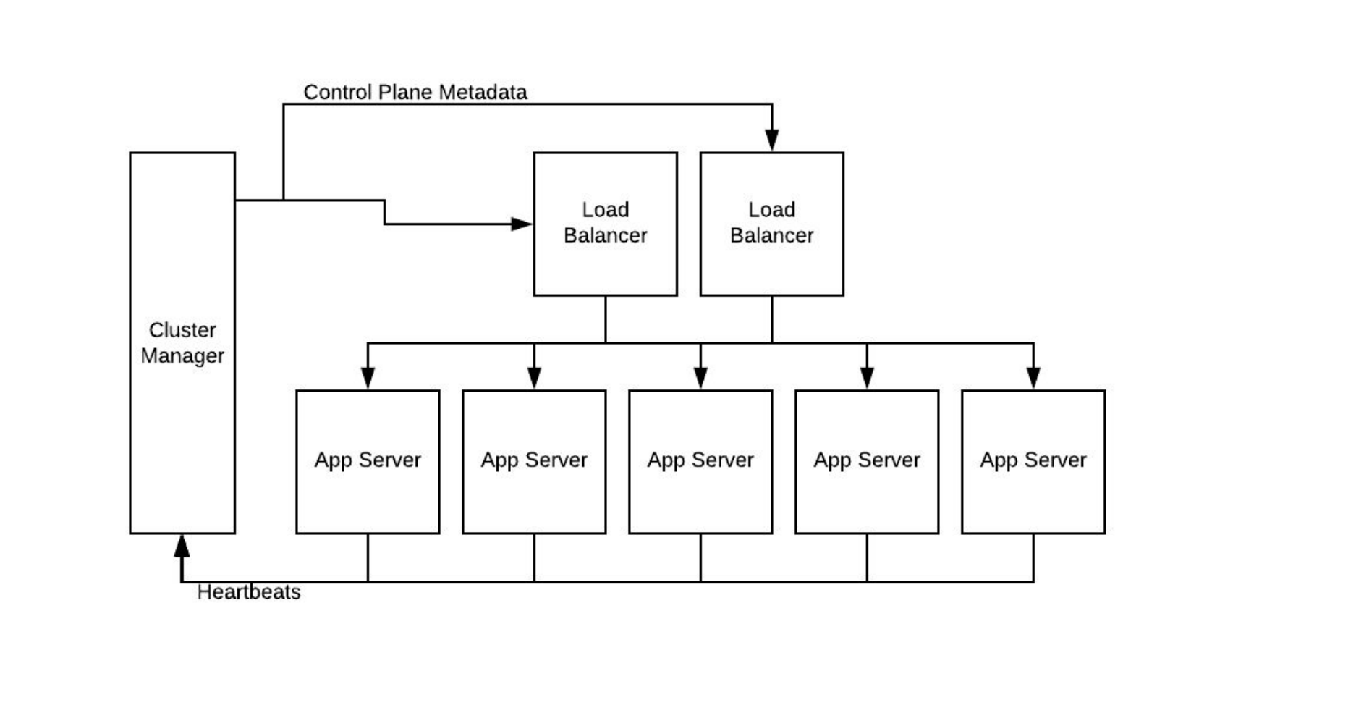
Distributed Architecture - PostService
Notes:
Note that the three tiers are being scaled within a single data center. Cluster manager for app tier could be Zookeeper (linkedin) or etcd (Niloy’s startup), Zookeper also used at Uber, Pinterest. Apache Helix is another option. Netflix uses hybrid of both horizontal and vertical partitioning.

Slide 41
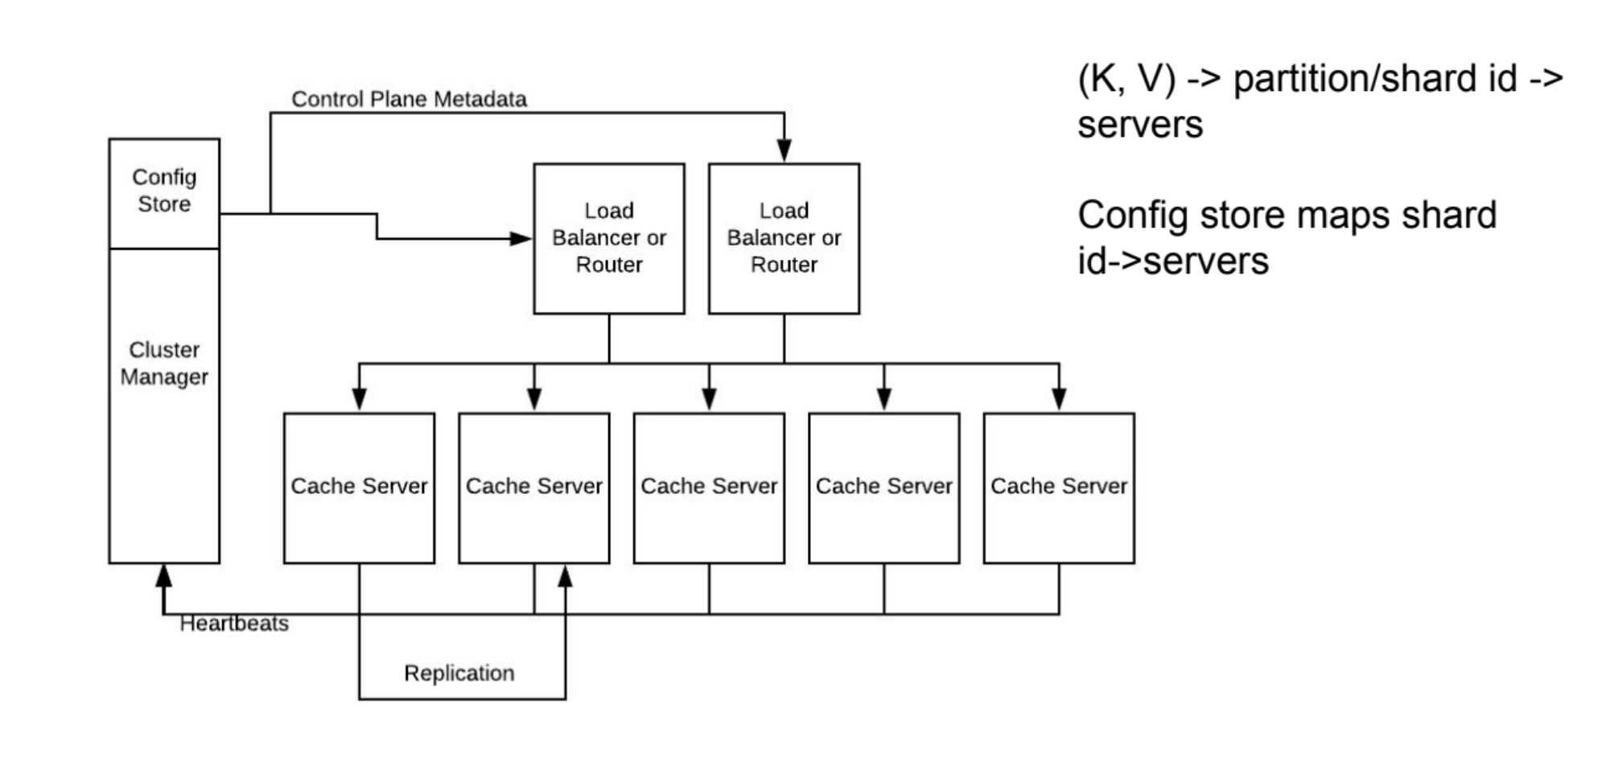
Distributed Architecture - PostService

Slide 42
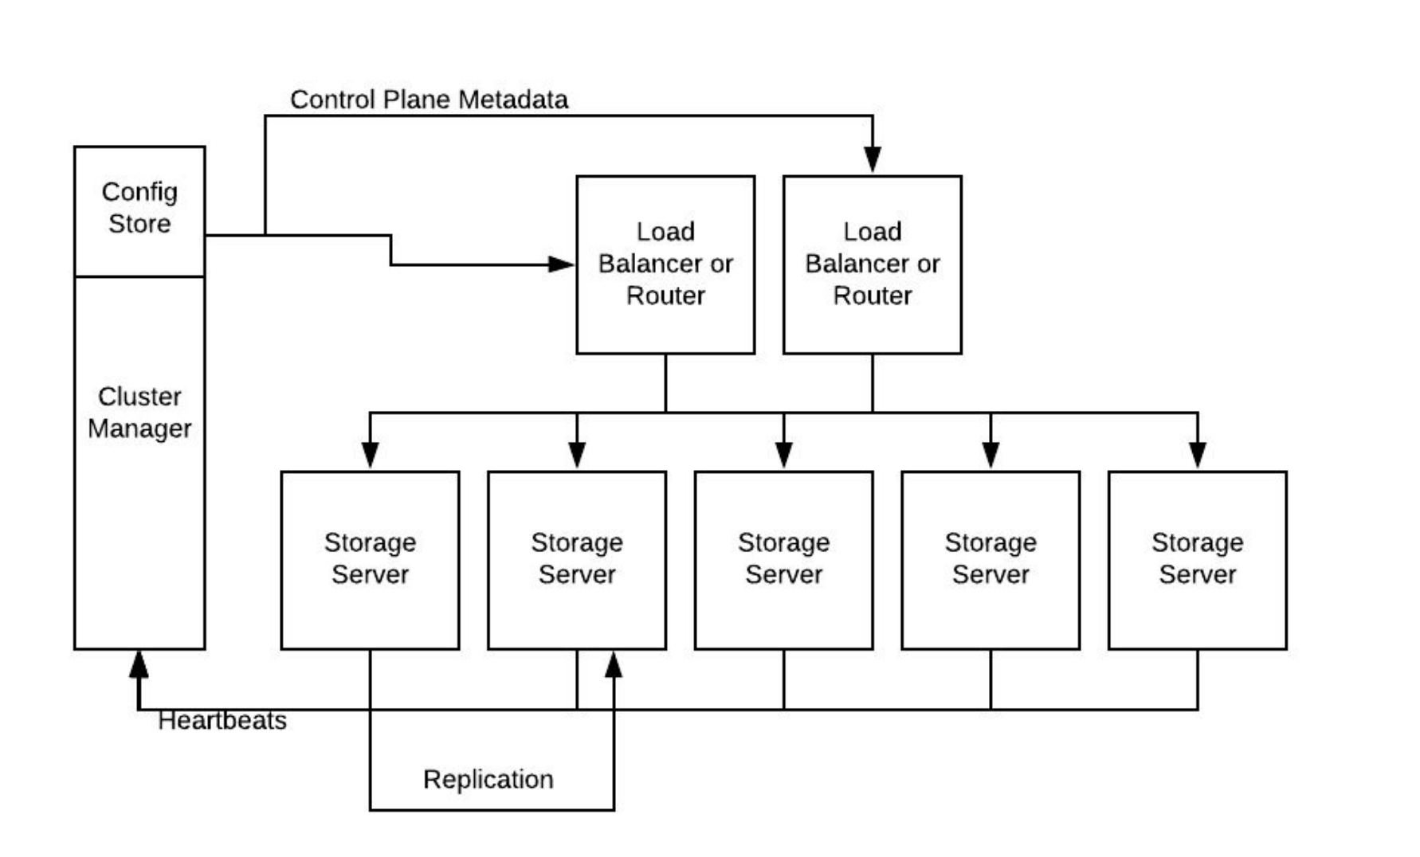
Distributed Architecture - PostService

Slide 43
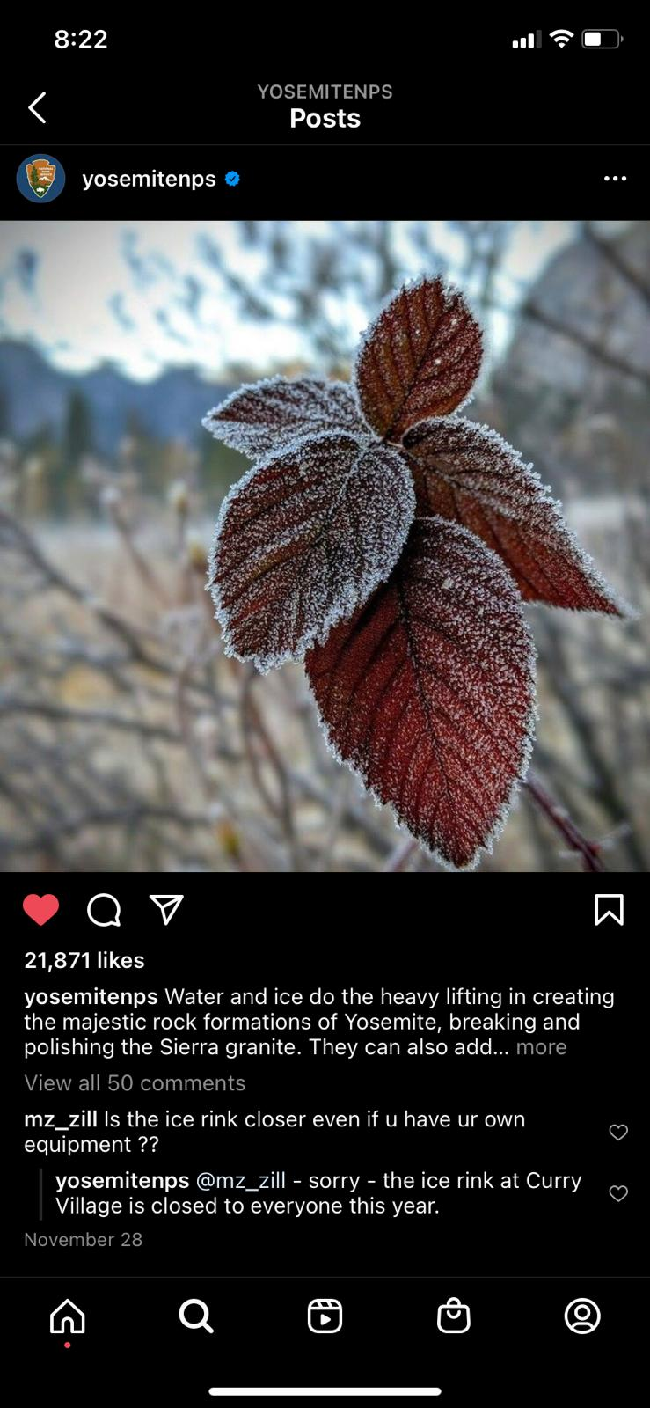
Step 4: ViewService
Tiers: App server tier, Cache or In-memory tier, Storage tier
Flow of APIs
Check if meta-data is available in cache
If yes, fetch and send it with cdn url
If not, read from db, fetch likes, comments
Update cache, return to user
Data Model: K-V pair
K: PhotoID: V: desc, img store path, other properties
K: UserID: V: a list of photos
How to store in Cache tier - Hashmap
How to store in Storage tier - as a row oriented K-V store
APIs
viewPhoto(PhotoID)
viewPhotos(UserID)
Algorithm in APIs
Simple K-V workload to fetch basic data (CRUD)
Fetch and aggregate like status, comments
Client
CDN
ViewService (App Tier)
ImageStore
Cache
DB

Slide 44
Step 5: ViewService: Scale up the solution
For each microservice
A deterministic set of reasons can be posed across all interviews
Need to scale for storage (storage and cache tiers) - Yes
Need to scale for throughput (CPU/IO) - Yes
Need to scale for API parallelization - No
Need to remove hotspots - No
Availability and Geo-distribution - Yes
Solve algebraically first and then put numbers
Total users ~= 1 billion
Daily active users ~= 500 million
Photo views per second ~= 20000
Average photo file size ~= 200kb
Let’s look at each tier separately.

Slide 45
Step 5: Need for scale in ViewService:
App Tier
Let t = CPU work time in ms from a single thread
So number of operations per second handled by single thread = 1000/t
Number of concurrent threads in a commodity server = 100-200 (determined by experiments)
So the number of API calls a server can handle per second ~ 100000/t, operating at full capacity.
But typical servers operate at 30-40% capacity, so roughly 30000/t API calls per server.
Since we are not sending the photo, but leveraging CDN, let’s assume that each photo fetch takes around 60 ms.
Plug in t = 60 ms in above formula = 30000/60 = 500 rps per server
For 20,000 views per sec ~= 20000/500 = 40 servers

Slide 46
Step 5: Need for scale in ViewService:
Cache Tier
Even though we did DB estimation for 10 years, we don’t need to store a fraction of that amount in cache.
We can store last 5 days worth of photos’ metadata in cache
So 5 days * 100,000 sec * 1000 pic per s ~= 500 million
500 million * ~200 bytes per pic (meta data) ~= 100 GB
Theoretically it could fit in 2 machines with 64 GB RAM

Slide 47
Step 6: Distributed Architecture in ViewService
Same as before
Stateless app servers
Shard the data
Consistent Hashing
CP or AP

Slide 48
News Feed
Things get a little complicated?

Slide 49
Logical Architecture (pretending we have 1 server)
News Feed Generation PostService
Client
Client
NewsFeedService
Q
FanOutService
PostService
Follow
Cache
FeedGenService
Cache
DB
DB

Slide 50
Step 4: NewsFeedService
System should generate a news feed for the user, based on who the user follows.
NewsFeedService should fetch top X (say 100) latest, most popular and relevant photos of the people that the user follows.
See if the info is available in cache. If not:
Get a list of people the user follows.
Fetch metadata of each user’s latest 100 photos.
Rank the photos (recency, what user liked, location etc).
Return top 100 of that subset.
Store the list in cache
Alternatively, FeedGenService could pre-generate the same and store it in UserNewsFeed table and in cache.
Generate new data based on last feed generation timestamp in the table.

Slide 51
Step 4: NewsFeedService
How should the user fetch the news feed?
Pull model: Clients pull the news feed from servers manually, or at a regular interval.
Pro: Less load on system while following celebrities.
Con: Empty pull requests if no data.
Push model (long poll or websockets): Servers push new data to users when it becomes available.
Pro: No wasted cycles from client in empty responses.
Con: Too much data to push for updates from celebrities.
Hybrid: Pull model for pulling data from celebrities and push model for rest of us mere mortals.

Slide 52
Step 4: NewsFeedService
Cache Tier
How to organize the news feed in cache?

Slide 53
Step 4: NewsFeedService
DB Tier
UserNewsFeed table:
Let’s assume we store 3 days worth of news feed items per user, 1000 feeds per day.
How do you cap it at 3 days?
UserId | FeedItemId | PhotoId | TimeStamp
1000001 | 1 | 20002 | 8/28/2021-09:10
1000001 | 2 | 40003 | 8/27/2021-16:10
1000002 | 1 | 3000001 | 8/28/2021-08:00

Slide 54
Step 5: Need for Scale in NewsFeedService:
For each microservice
A deterministic set of reasons can be posed across all interviews
Need to scale for storage (storage and cache tiers) - Yes
Need to scale for throughput (CPU/IO) - Yes
Need to scale for API parallelization - No
Need to remove hotspots - No
Availability and Geo-distribution - Yes
Solve algebraically first and then put numbers
Total users ~= 1 billion
Daily active users ~= 500 million
Avg num of timeline fetches a day by each active user ~= 10
Photo views per second ~= 500,000
Average photo file size ~= 200kb
Let’s look at each tier separately.

Slide 55
Step 5: Need for Scale in NewsFeedService:
App Tier
Timeline fetch req = 500 million daily active users * 10 fetches a day = 5 billion a day
= 5,000,000,000 / 100,000 (approx sec in a day) = 50,000
Using previous formula, roughly 30000/t API calls per server.
Since we are not sending the photo, but sending a batch of meta-data, let’s assume that each fetch takes around 100 ms.
Plug in t = 100 ms in above formula = 30000/100 = 300 rps per server
For 50000 requests per sec ~= 167 servers.

Slide 56
Step 5: Need for Scale in NewsFeedService:
Cache Tier
Let’s assume we store 500 news feed items per active user.
So 500 million users * 500 items * 30 bytes per item = 7,500,000,000,000 ~= 7.5 TB
For easier calculations, assume 75 GB RAM per server
So 7.5 TB / 75 GB ~= 100 servers
How do you store it in these server?

Slide 57
Step 5: Need for Scale in NewsFeedService:
DB Tier
Let’s assume we store 3 days worth of news feed items per user, 1000 feeds per day.
So 1 billion users * 3000 items * 30 bytes per item = 90,000,000,000,000 ~= 90 TB
Assume 1 TB per DB shard
So 90 TB / 1 TB ~= 90 DB servers

Slide 58
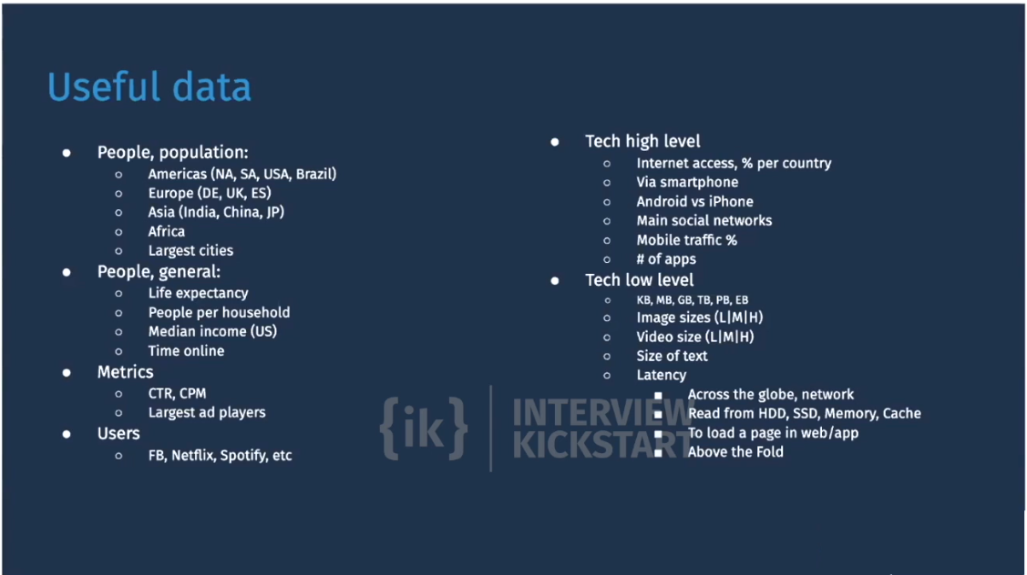
Step 6: Distributed Architecture for NewsFeedService
For App tier, round robin would suffice unless you are holding the cache on the same servers
For cache tier, shard based on User ID
For DB tier as well, shard based on User ID
Explain how APIs will work in this sharded setting

